Slide 1
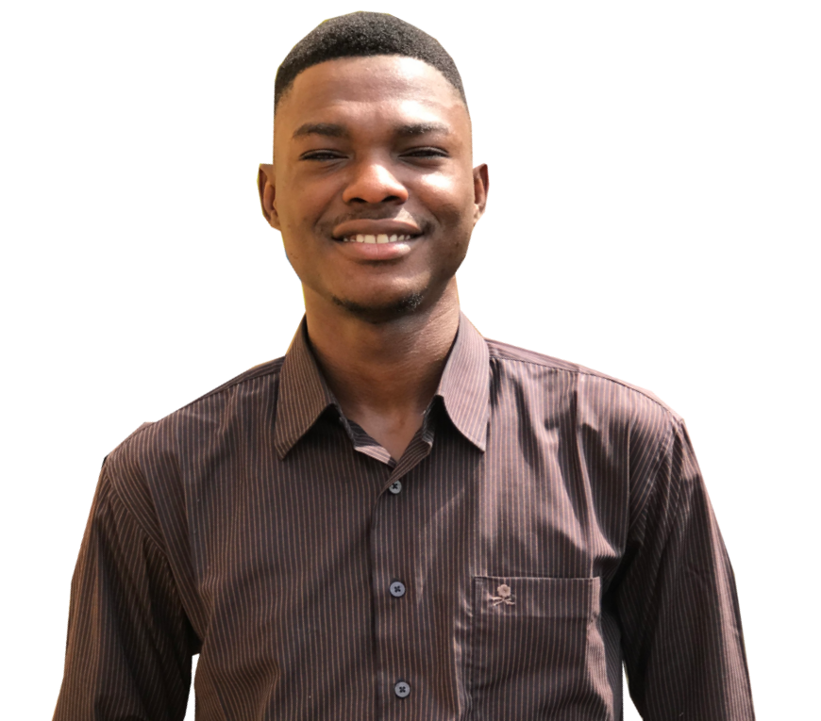
HOME PROJECTS ABOUT CONTACT
Adegunle Raphael Tobi is……………… write little in About and write Read More… or used Iframe to frame About.
PROJECT SLIDER AND OTHER DEPARTMENTAL AND AWARD IMAGE
WHAT PEOPLE SAYS ABOUT RAPHAEL

Slide 2
HOME PROJECTS ABOUT CONTACT
MY PORTFOLIO
LIST OF PROJECTS:
Data Analysis
Slides
Then write up
Website
Slides
Then Write up
Bibliographies
Slides
Then Write up
QUOTE WHICH WILL CHANGE Using Javascript

Slide 3
HOME PROJECTS ABOUT CONTACT
MY PORTFOLIO
SLIDER OF PERSONAL IMAGE
USING GRID DISPLAY
ABOUT WHICH INCLUDE:
BACKGROUND
SKILLS
ACADEMIC
EXPERIENCE
QUOTE WHICH WILL CHANGE ON HOVER

Slide 4
HOME PROJECTS ABOUT CONTACT
MY PORTFOLIO
HOME ADDRESS
EMAIL ADDRESS
PHONE NUMBER
LINKEDIN
FACEBOOK PAGE
TWITTER
GITHUB PAGE

